Slide 1

Business Analysis with Yelp
By Group 2: Yuanshan Zhang, Ananya Anand, Shubham Mishra, Shizuka Takahashi, Ruiqi Jiang

Slide 2


Data Description
Contains business data including name, address, categories, and so forth.
113.4MB
business.json
Contains full review text data, including the user (user_id) who wrote the review and the business (business_id) for which the review was written.
4.98GB
review.json
User data including the user's friend mapping and all metadata associated with the user.
3.13GB
user.json
Check-ins on a business.
273.7MB
checkin.json
Tips written by a user on a business. Tips are shorter than reviews and tend to convey quick suggestions.
172.2MB
tip.json

Slide 3
Background
This Yelp analysis notebook provides a comprehensive evaluation of the situation and trends, especially focusing on businesses and reviews.
Merchant perspective
User perspective
Grasping client emotions
Customer satisfaction levels
Geographical distribution of businesses
Enhance the users experience
Focusing on the aspects that users are most concerned about
Easier for users to find restaurants that match their preferences

Slide 4
Roadmap
Data Cleaning &
EDA
Modeling
Insights
Missing/Duplicate
Flatten business attributes
Data visualizations
Text mining
Clustering on business attributes
Clustering on user data
Topic modeling on tip & review data
Pre-trained sentiment model on review data
Users
Products
Services

Slide 5
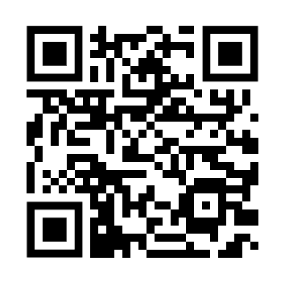
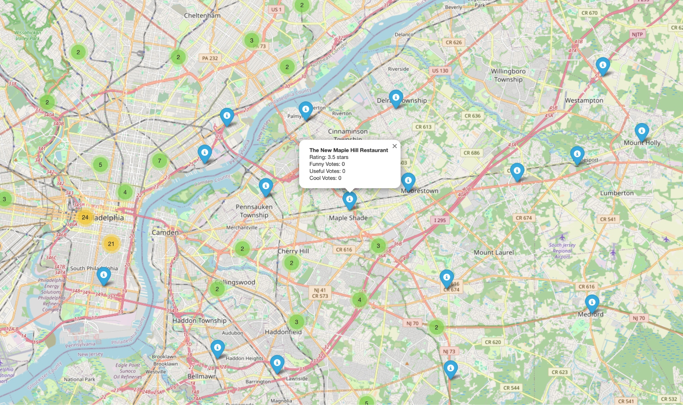
Data Preprocessing/EDA
Rename duplicate columns
Check and drop null and duplicate values
Convert date to timestamp
Lower case, remove special characters, tokenize, and remove stop words
https://gleaming-dragon-85a398.netlify.app
Notes:
We have performed exploratory data analysis by creating a folium map to allocate each point which is yelp user on a folium map using pyspark. As you can see from the screenshot, we have added pop-up messages for clear information visible for the users. You can use the qr code to open the map on your cell phones, it is highly interactive and super user friendly.

Slide 6
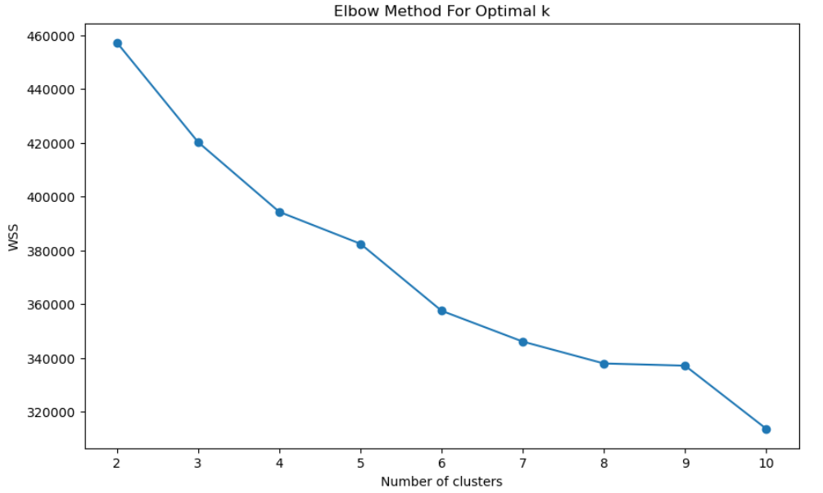
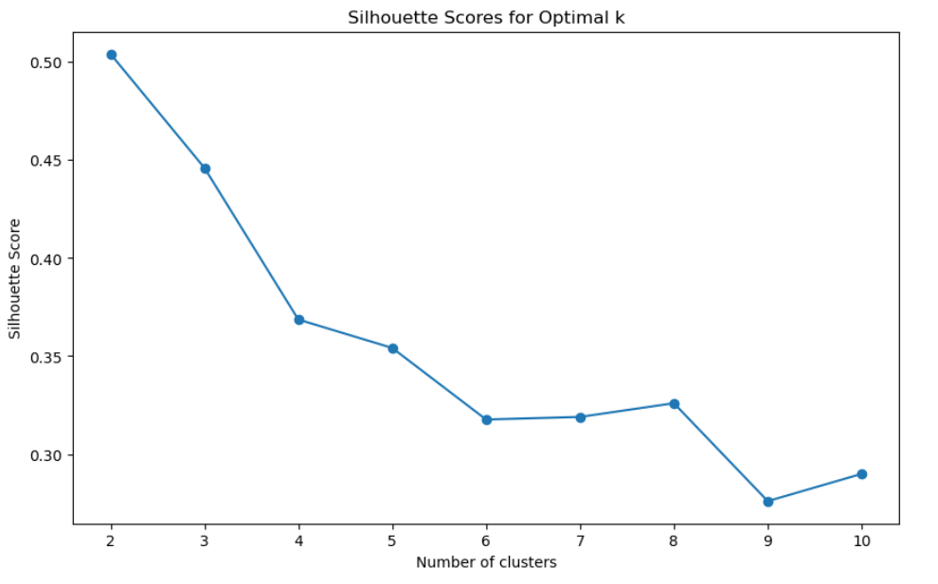
Business Clustering
Best K = 3
Notes:
The elbow curve is relatively smooth, making it difficult for us to identify a point where the graph displays a sharp decrease, so we're still unable to determine the most suitable number of clusters. Next we are using silhouette to try to get the cluster. The silhouette score is highest for two clusters. However, two clusters may not be the optimal choice. The silhouette score for three clusters is only slightly lower than that for two, and in the elbow plot, the reduction from two clusters to three clusters is around 40000, the most significant decrease among adjacent cluster numbers. Therefore, three clusters may be a more appropriate choice.

Slide 7
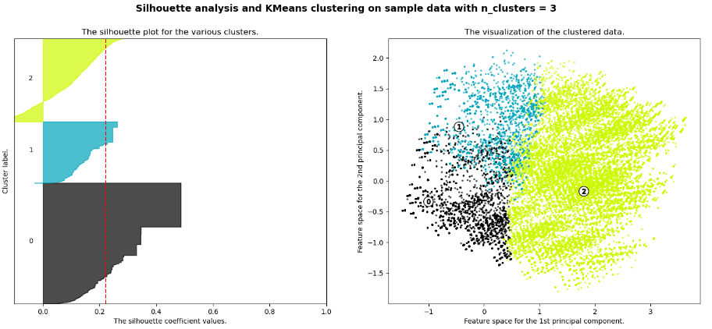
Business Clustering
Notes:
We further validated the choice of three clusters using the Silhouette score. The left side is our Silhouette analysis plot and the right side is Scatter plot using PCA for dimensionality reduction. The distribution of points within each cluster is relatively balanced, and the boundaries between clusters are also clear.

Slide 8
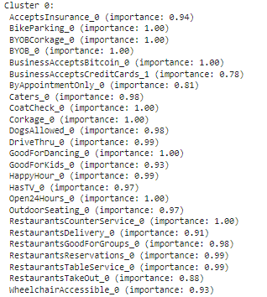
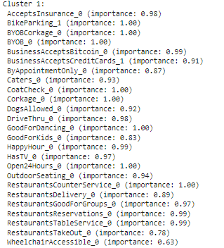
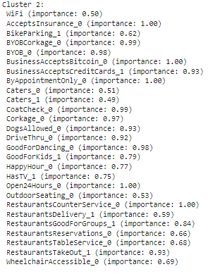
Business Clustering
Premium Amenities Cluster
Selective Convenience Cluster
Tech-Friendly Services Cluster
Notes:
1. Cluster 0 could named Premium Amenities Cluster.This cluster has features like 'AcceptsInsurance', 'BikeParking', and 'Corkage' with high importance (1.00), which might indicate establishments that cater to more upscale or specialized services. Features like 'BusinessAcceptsCreditCards_1' are slightly less important (0.78) but still significant. It seems to represent businesses that are more likely to offer a wider range of amenities.
2. cluster 1 could named Selective Convenience Cluster.'WiFi' has an importance of 0.50, indicating a moderate representation within the cluster. High importance is seen in 'BusinessAcceptsBitcoin_0', 'ByAppointmentOnly_0', and 'RestaurantsCounterService_0', suggesting a tech-friendly and modern service approach. This cluster also shows diversity in 'Caters_0' and 'Caters_1', meaning catering services might be a split feature among here..
3. Cluster 2 could named Tech-Friendly Services Cluster.Across all clusters, features that have an importance of 1.00 can be considered the most defining characteristics of that cluster. When naming clusters, one approach is to identify the most defining features (highest importance) that differentiate one cluster from the others and use them to create a descriptive name that summarizes the cluster's essence.

Slide 9
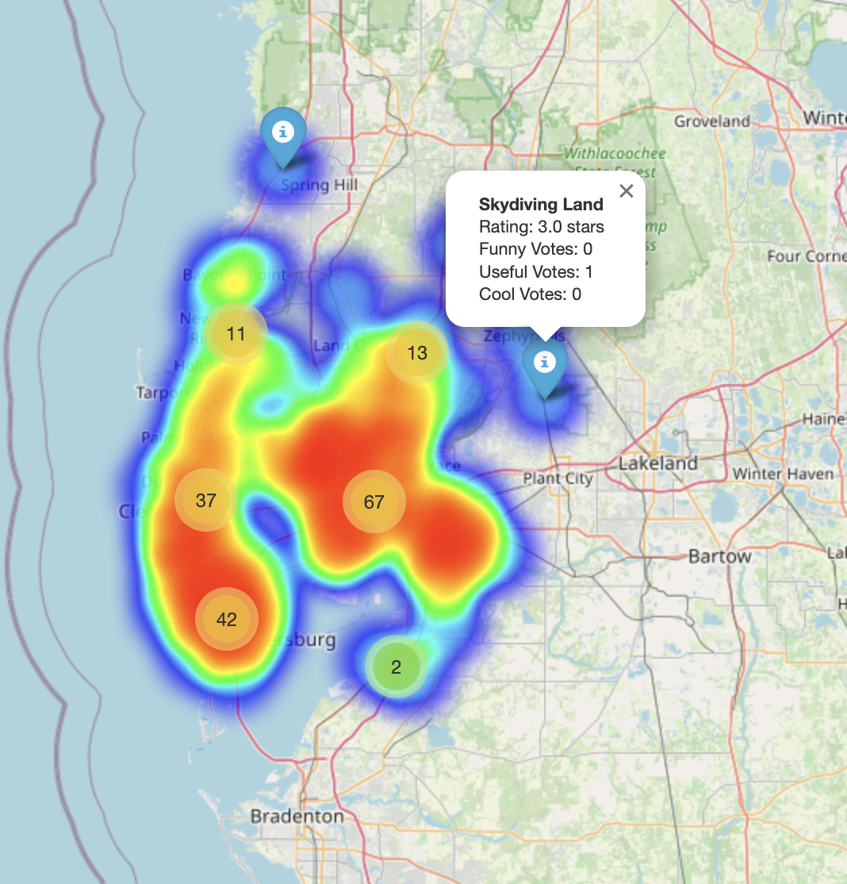
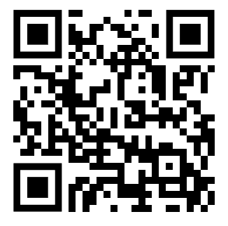
How are the Business Rating distributed?
https://helpful-kheer-05df1d.netlify.app
Notes:
Red areas of the heatmap show areas with high business star ratings and the lighter color areas of the heatmap show areas with lower business star ratings.

Slide 10
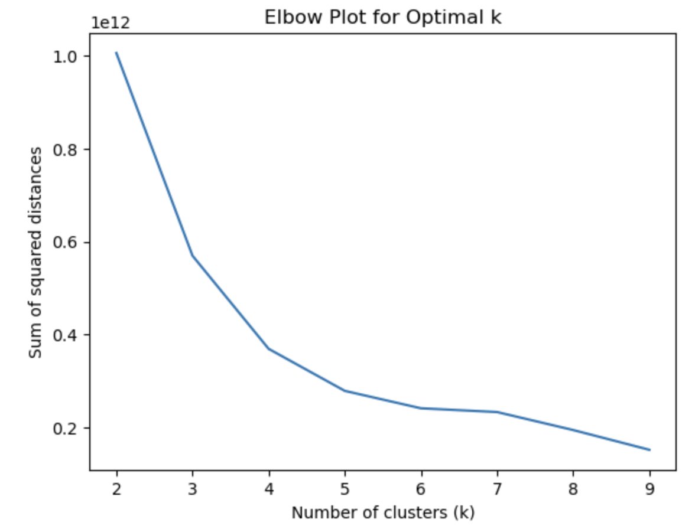
K-means Clustering on User
Number of Clusters = 3
Notes:
It is clear from this plot that three is a turning point, beyond which the rate of inertia reduction slows significantly. Therefore, three clusters are the optimal choice for the user dataset.

Slide 11
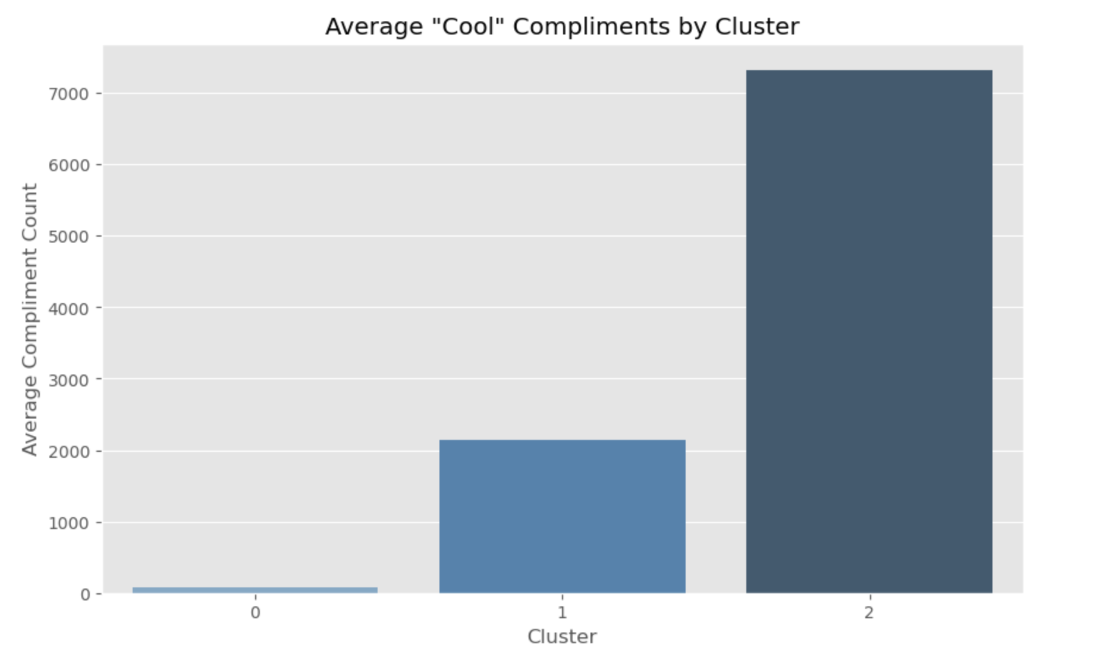
Compliment Profile Clustering
Cluster 2 has the highest “Cool” users. Cluster 2 users could be perceived as trendy, stylish, while Cluster 0 users may be perceived less engaged with the platform.
Notes:
Cluster 2 users could be perceived as trendy, stylish, while Cluster 0 users may be perceived less engaged with the platform.
Users in Cluster 2 might be more active in sharing interesting or captivating content, leading to more "cool" and "cute" compliments from other users.

Slide 12


NLP (Natural Language Processing)
Higher level NLP features
Normalizer
Stemmer
Lemmatizer
Pre-trained language models
Pre-trained pipelines
LLM embeddings
Basic NLP features
Tokenizer
StopwordsRemover
CountVectorizer
IDF
Models such as LDA
Pipeline
Notes:
Since our data contains 7 millions reviews, NLP becomes the most important aspect of our analysis. However, Spark MLlib only offers limited and lower level NLP features such as tokenizer, stopwords remover, etc. Applying higher level NLP techniques with high efficiency becomes the biggest challenge in our project. After researching on third party libraries, we decided to use Spark NLP, which is an open-source NLP library developed by John Snow Labs, built on top of Apache Spark and TensorFlow, offering a range of higher level features such as … Moreover, Spark NLP is commonly viewed as the best option for NLP tasks in Spark.

Slide 13
Topic Modeling with LDA(Latent Dirichlet Allocation)
Topic Modeling
Describes the broad task of assigning topics to unlabeled text documents
LDA
Popular technique for topic modeling
Generative probabilistic model
Bag of Words/TF-IDF
Find groups of words that appear frequently together across different documents
Output probabilistic distribution of the topics
Notes:
Our tour with Spark NLP begins with topic modeling. In general, topic modeling refers to the broad task of assigning topics to unlabeled text documents. And the model we pick is the Latent Dirichlet Allocation. LDA is a popular technique for topic modeling. It is a generative probabilistic model that takes Bag of Words or TF-IDF as input, finds groups of words that appear frequently together across different documents, and output probabilistic distribution of the topics.

Slide 14
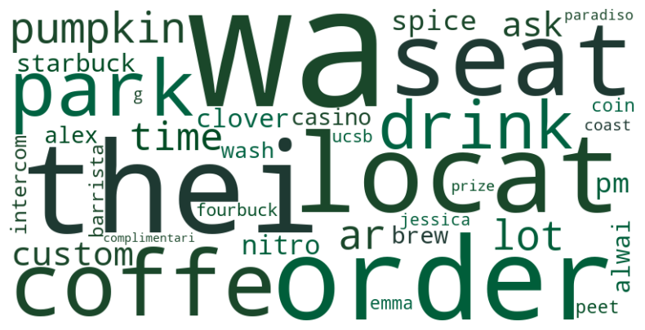
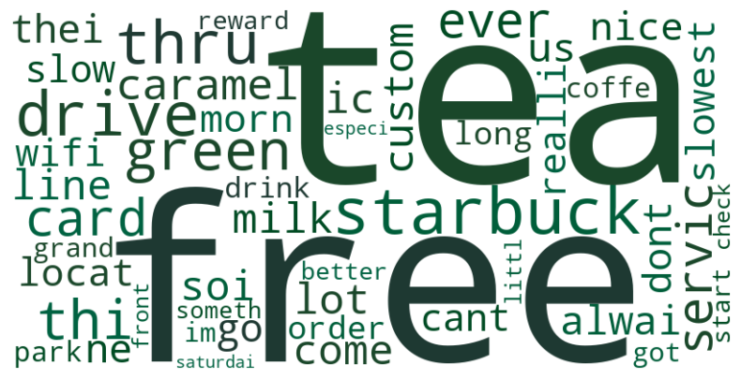

Topic Modeling - Starbucks Example
Review
Tip
Notes:
Topic modeling is a useful tool for businesses to understand what are products that receives more customers’ attention as well as identify aspects of services they can improve. Here, we use Starbucks as an example. We observe that in the review dataset, many reviews are centered around ‘pumpkin spice’ and ‘nitro brew’. So, we would recommend Starbucks to pay special attention to the reviews of these two products. In the tip dataset, there are many tips centered around ‘wifi’, ‘park’, ‘free’, and ‘slow’, so we can help Starbucks to develop business strategies such as improving app ordering services and providing free wifi to keep and attract customers.

Slide 15

Sentiment Analysis using Pre-trained NLP models
Sentiment Analysis
Categorize reviews into positive, negative, and neutral
7 million reviews and limited resources
Using pre-trained models is a commercial and feasible resolution
Pre-trained NLP Model
Spark NLP - ‘sentimentdl_use_imdb’
Trained on IMDB reviews
IMDB reviews have document length and tone similar to Yelp reviews

Slide 16
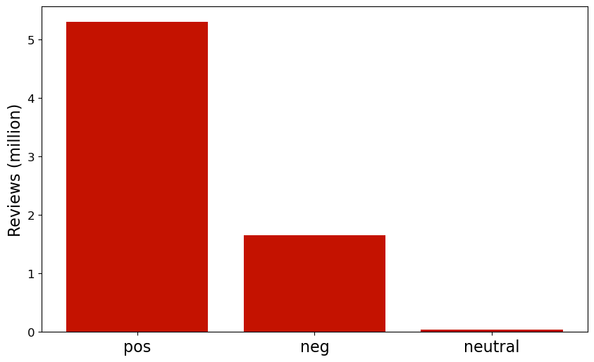
Sentiment Analysis
The Distribution of Sentiment Across All the Reviews
Positive reviews are the most common.
Negative reviews are about 1/3 of positive reviews.
Neutral reviews are the least.

Slide 17
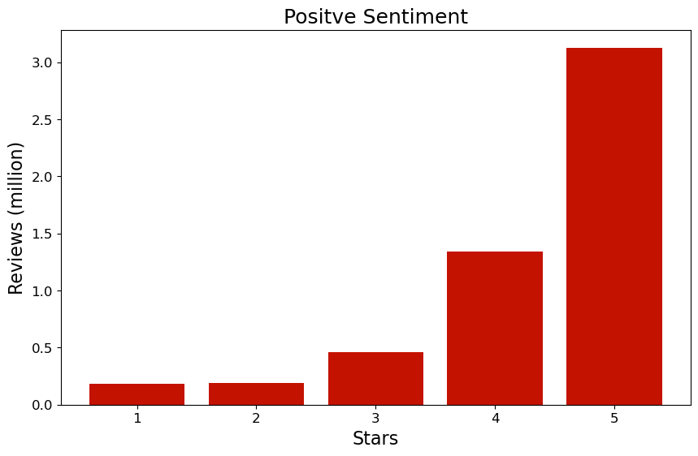
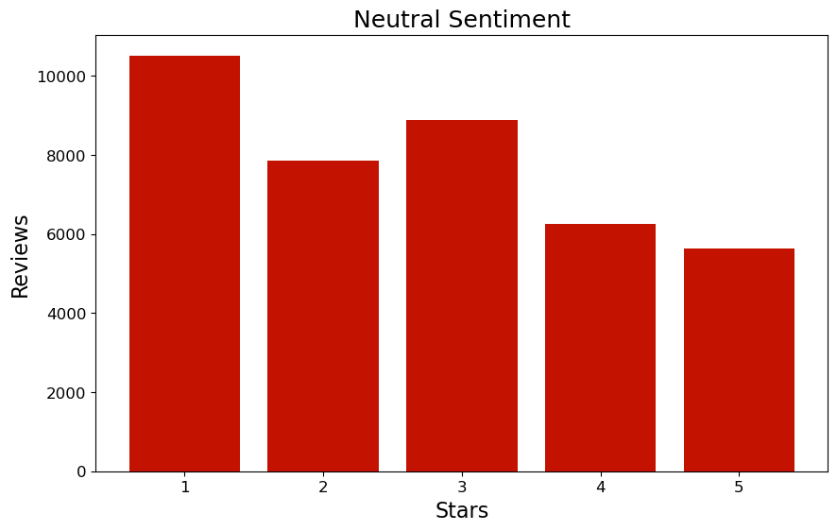
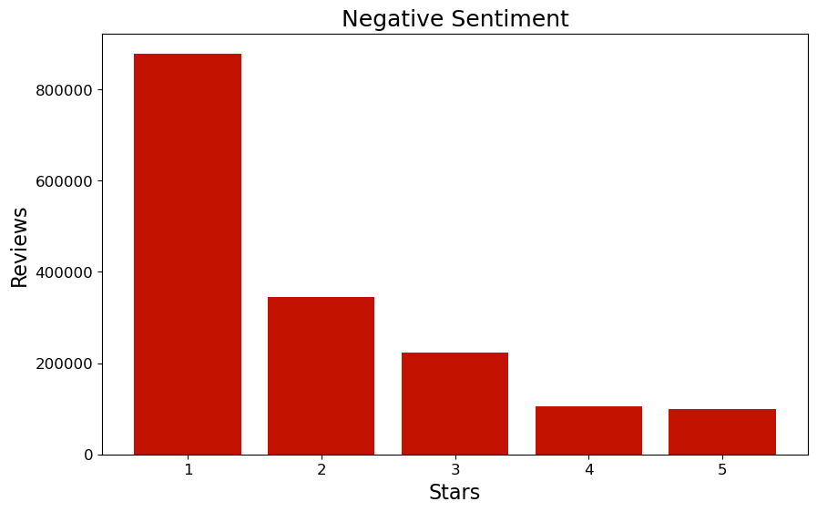
Sentiment Analysis
'...The food is good but it takes a very long time to come out The waitstaff is very young but usually pleasant We have just had too many experiences where we spent way too long waiting…'
Notes:
Positive with the rating of 3, the food is good but services can be improved. Positive但低星，negative但高星有很多有用的insights accuracy也不完全准，会有一些error。

Slide 18
Challenges
Long runtime due to the large dataset
Spark MLlib does not support high level NLP features
Unable to use third party NLP libraries
Configure Spark NLP in Dataproc
Research on how to use Spark NLP
Streamline Spark NLP and Spark MLlib transformers using pipeline
Perform analysis after applying models

Slide 19

Thank you!

